Slide 1
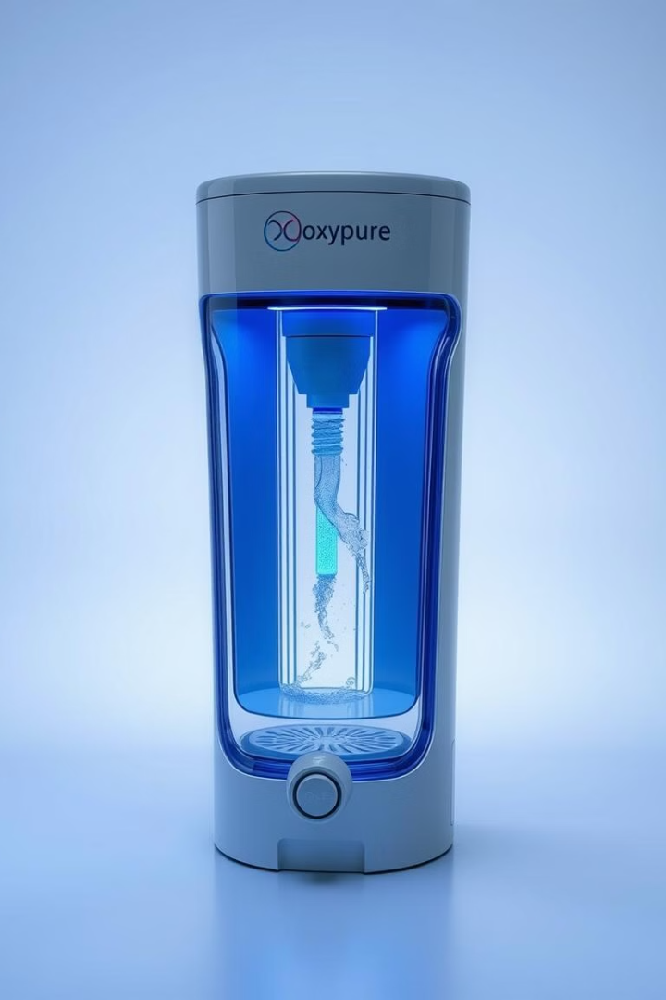
G H Raisoni College of Engineering , Nagpur
OxyPure: Revolutionizing Water Filtrater with ozone gas as Filtaration medium
Aruna Sudame , Shreyanshu Dhawale , Dhiraj Ikhar
~Information Technology

Slide 2
The Need for Innovative Water Solutions
INTRODUCTION
Global Issue
Conventional Approaches
Access to clean, safe drinking water is a global issue worsened by pollution, industrialization, and population growth.
Conventional methods like chemical treatments and filtration can be inefficient and produce harmful byproducts
Novel Solution
Sustainability
This research presents a novel water filtration system using ozone gas for its strong oxidizing properties
The system offers a sustainable, eco-friendly alternative, removing microorganisms, pollutants, and chemicals without toxic residues.

Slide 3



OxyPure's Unique Filtration Technology
Multi-Stage Filtration
Oxidation Technology
Framework Design: Integrated an ozone generation unit into a custom-designed framework to ensure controlled ozone dispersion.
Oxidizing Action: Leveraged ozone's powerful oxidation properties to degrade microorganisms, organic pollutants, and chemical contaminants.
Optimization: Focused on maximizing contact time for effective filtration and disinfection.
Disinfection Efficiency: Focused on effective oxidation and disinfection without leaving harmful byproducts.
Performance Testing: Used water samples with various contaminants, evaluated through microbial assays, chemical analysis, and turbidity measurements.
Energy & Sustainability Assessment: Evaluated the system's energy efficiency and environmental impact to ensure long-term sustainability.
Parameter Adjustments: Key factors like flow rate, ozone concentration, and reaction time were adjusted to determine optimal conditions.
Scalability: Provided a comprehensive approach for scaling the technology with an emphasis on maintaining high efficiency and low environmental impact.

Slide 4

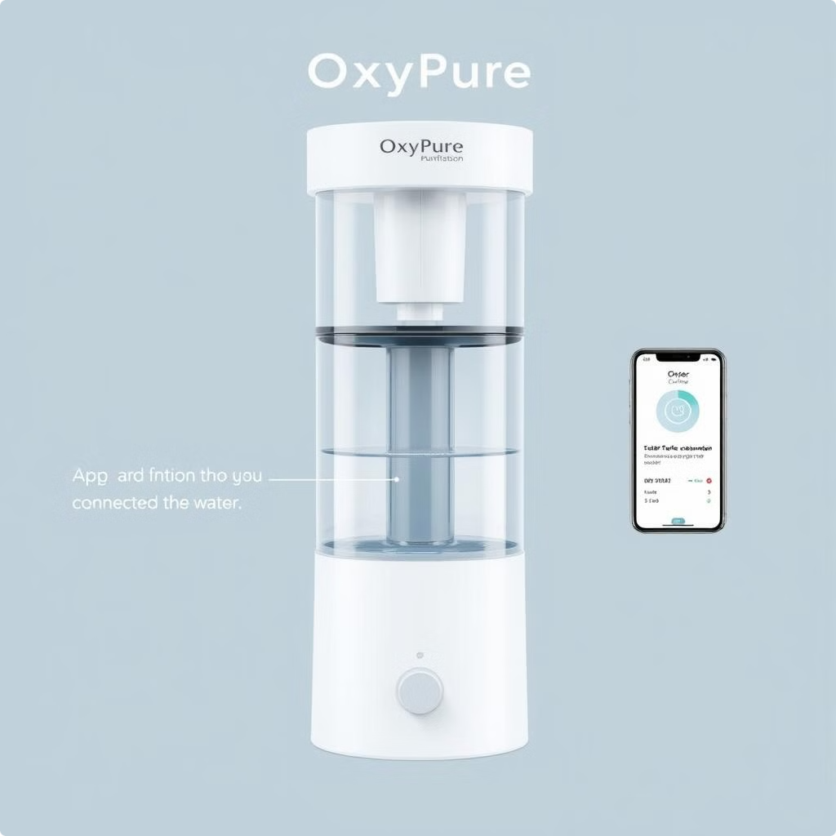
Unparalleled Purification: How OxyPure Will Work
1
Ozone Generation
2
Ozone Injection into water
3
Oxidation and Disinfection
4
Contact Time
5
Decomposition of Ozone
6
Post Filteration (optional)
The post filtercan be introduce as accesory for filterization.
7
Monitoring and Control
This will be observed in the Oxypure application providing ll the required information to user and other maintainance reminder

Slide 5

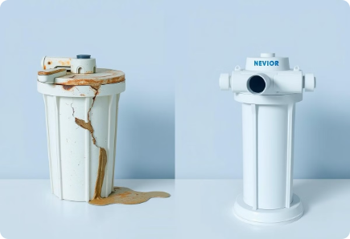



Pre Existing water filteration Techniques
• Activated Carbon Filtration
• Distillation
• Sand Filtration
• Reverse Osmosis (RO)
• Ion Exchange
• Ceramic Filtration
• UV (Ultraviolet) Purification
• Sedimentation
• Chlorination

Slide 6
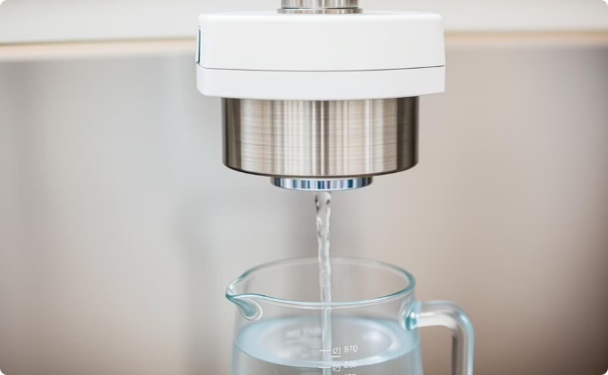
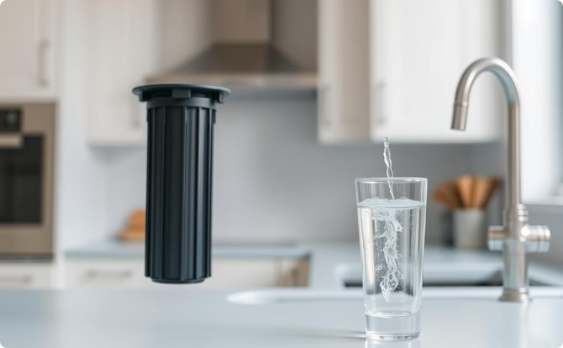
OxyPure's Versatile
Key features and Applications
Effective Oxidation: Utilizes ozone gas to eliminate bacteria, viruses, and organic pollutants.
Wider Contaminant Removal: More effective than Activated Carbon and RO.
Chemical-Free: Decomposes into oxygen, leaving no harmful byproducts.
No Residues: Leaves only oxygen, unlike Distillation and Ion Exchange.
Rapid Purification: Provides quick and efficient disinfection.
Faster: Purifies water more quickly than UV and RO.
Energy Efficient: Optimized for low energy use.
Low Maintenance: Requires no frequent filter replacements.
Scalable: Suitable for both small and large-scale applications.
Eco-Friendly: Chemical-free and sustainable, unlike Chlorination.

Slide 7
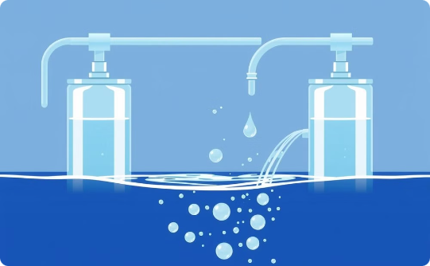
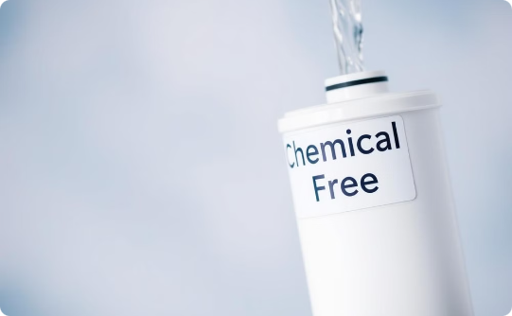
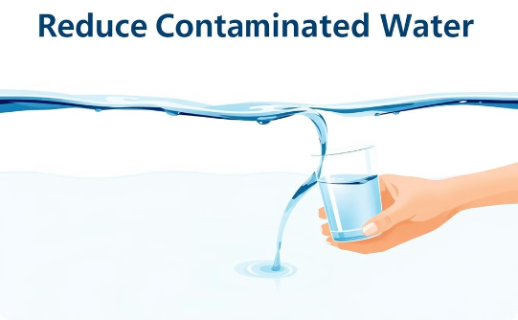
Advantages of OxyPure's Filtration .
Effective Disinfection: Ozone is a powerful disinfectant, capable of killing bacteria, viruses, and other pathogens quickly and efficiently..
Chemical-Free Process: Ozone decomposes into oxygen after use, leaving no harmful chemical byproducts.
Broad Spectrum of Contaminant Removal: Ozone can degrade a wide range of contaminants, including organic compounds, chlorine byproducts, and heavy metals.

Slide 8
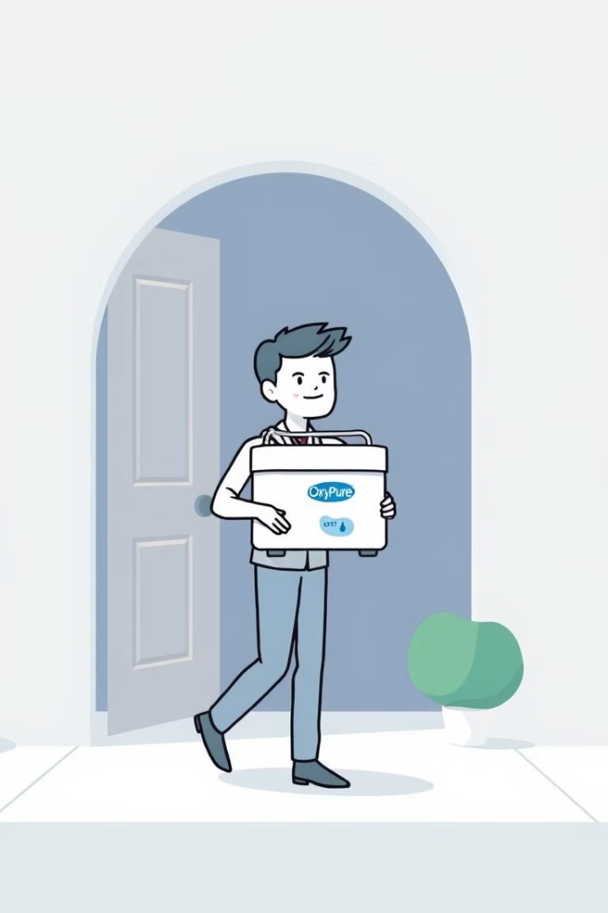





The OxyPure Prototype and Future Roadmap
Prototype Development
Designing the Hardware/module with provided funds
Collection & Connection of apparatus
Creation of hardware with the provided funds and Lab testings
Working on IoT
After completion of hardware setup, Connecting it with OxyPure application.
Final testing of Prototype.
Testing the OxyPure water filter and getting certified.
Deliver
Using in Day to day life.

Slide 9
THANK YOU!
"Choose OxyPure: Clean Water, Clean Future."
Thank you for your time and attention in exploring the innovative OxyPure water filtration solution. We hope this inspires a shift towards smarter, greener, and more efficient water purification methods.
YOU CAN CONTACT US THROUGH OUR EMAILS
📧 Aruna Sudame : aruna.sudame@raisoni.net
📧 Shreyanshu Dhawale :shreyanshu.dhawale.it@ghrce.raisoni.net
📧 Dhiraj Ikhar : dhiraj.ikhar.it@ghrce.raisoni.net:
~Team OxyPure

